Slide 1
NET CHARGES
Whenever a net is driven by a signal, it takes the logic value of the signal
When the signal source is tri-stated, the net too gets tri-stated
In practice the net can have a capacitor associated with it, which can store the signal level even after the signal source dries up (i.e., tri-stated)
To account for this situation, a charge storage capacity is associated with the net
Such nets are declared with the keyword trireg
By virtue of the inherent capacitance associated with them, trireg nets can never be in the high impedance state – that is, they can assume 0, 1, or x value only

Slide 2
NET CHARGES –CONT’D
A trireg net can be in one of two possible states only:
Driven state:
When driven by a source or multiple sources, the net assumes the strength of the source. It can be any of the strengths specified in Table 1 except the high impedance value.
Capacitive state:
When the driven source (sources) is (are) tri-stated, the net retains the last value it was in – by virtue of the capacitance associated with it. The value can be 0, 1 or x (but not the high impedance value).

Slide 3
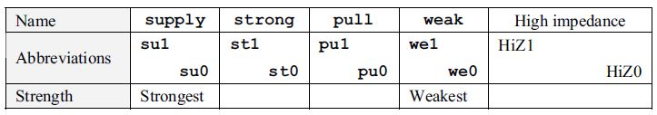
Table 1 Strength levels associated with outputs of gate primitives

Slide 4

NET CHARGES –CONT’D
When in the capacitive state, a net can have a storage strength associated with it
Three such storage strengths are possible – namely large, medium, and small
When a storage strength is not specified, it is assigned the default value – medium
For a trireg net one cannot assign storage strength capacity separately for the 0 and the 1 states
A trireg net can be driven with possibilities of contention from two or more sources
Table 2 Capacitive storage strengths on nets

Slide 5
EXAMPLE NET STORAGE
Consider the design in Figure 1. As long as the signal control = 1, the signal out follows the signal in
When control goes to 0, out is disconnected from the input and it '‘floats.'’ It retains the last value due to the capacitance storage capacity
The storage strength is medium, signifying a medium value of capacitance

Slide 6
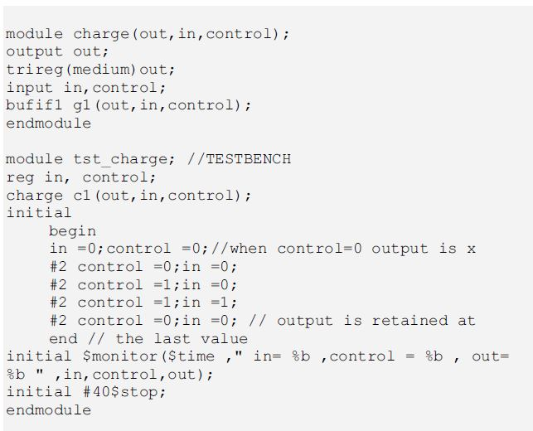
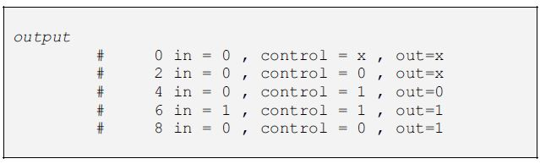
EXAMPLE NET STORAGE –CONT’D
Figure 1 Illustration of net storage; the test bench and simulation results are also shown
in the figure.

